Slide 1
1.2
Fractions!!!

Slide 2
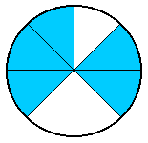
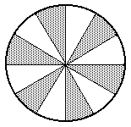
Parallel
Example 1
Identifying Fractions
Write fractions for the shaded and unshaded portions of each figure.
a.
b.
The figure has 8 equal parts.
There are 5 shaded parts.
shaded portion
unshaded portion
The figure has 12 equal parts.
There are 6 shaded parts.
shaded portion
unshaded portion

Slide 3


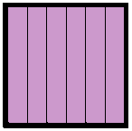
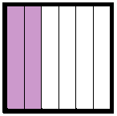
Parallel
Example 2
Representing Fractions Greater Than 1
Use a fraction to represent the shaded part of each figure.
a.
b.
An area equal to 7 of the ¼ parts is shaded. Write this as
An area equal to 8 of the 1/6 parts is shaded. Write this as

Slide 4
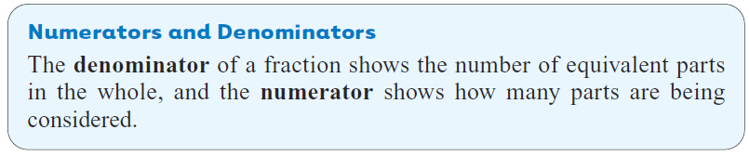
In the fraction ¾, the number 3 is the numerator and the 4 is the denominator. The bar between the numerator and the denominator is the fraction bar.
Numerator
Fraction bar
Denominator

Slide 5
Parallel
Example 3
Identifying Numerators and Denominators
Identify the numerator and denominator in each fraction.
a.
b.
Numerator
Denominator
Numerator
Denominator

Slide 6
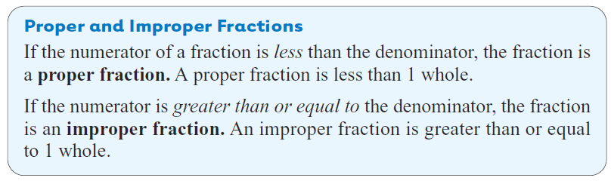
Proper Fractions
Improper Fractions

Slide 7
Parallel
Example 4
Classifying Types of Fractions
a. Identify all proper fractions in this list.
Proper fractions have a numerator that is smaller than the denominator. The proper fractions are shown below.
b. Identify all the improper fractions in the list
above.
A proper fraction is less than 1.
An improper fraction is equal to or greater than 1.

Slide 8
Mixed Numbers

Slide 9
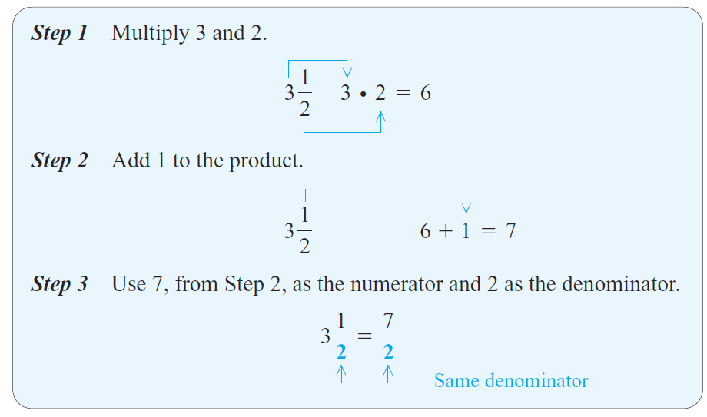
Writing a Mixed Number as an Improper Fraction
Change 3 ½ to an improper fraction.

Slide 10
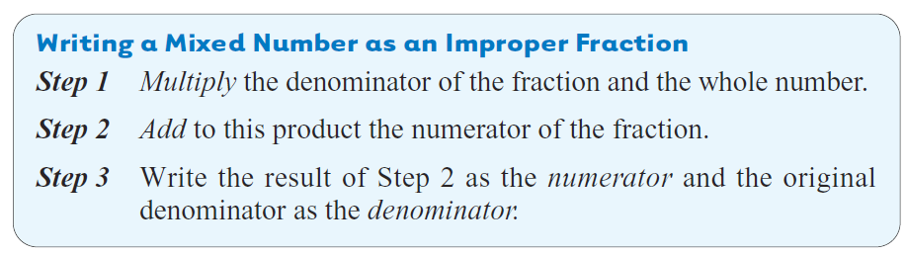
Use the following steps to write a mixed number as an improper fraction.

Slide 11
Parallel
Example 1
Writing a Mixed Number as an Improper Fraction
Write as an improper fraction (numerator greater than denominator).
Step 1
Multiply 5 and 9.
Step 2
45 + 8 = 53
Add 8. The numerator is 53.
Step 3
Use the same denominator.

Slide 12
Parallel
Example 2
Writing Improper Fractions as Mixed Number
Write each improper fraction as a mixed number.
a.
Whole number part
Divide 14 by 3.
12
2
Remainder
The quotient 4 is the whole number part of the mixed number. The remainder 2 is the numerator of the fraction, and the denominator stays as 3.
Remainder

Slide 13
Parallel
Example 2
continued
Writing Improper Fractions as Mixed Number
Write each improper fraction as a mixed number.
b.
Whole number part
Divide 48 by 6.
48
0
Remainder

Slide 14
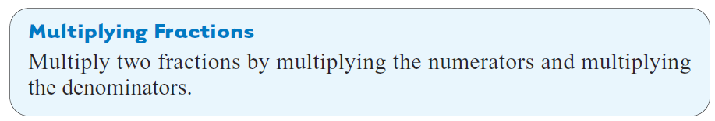
Slide 2.5- 14

Slide 15
Parallel
Example 1
Multiplying Fractions
Multiply. Write answers in lowest terms.
a.
b.
Multiply the numerators and multiply the denominators.
Lowest terms
Lowest terms

Slide 16
Parallel
Example 2
Using the Multiplication Shortcut
Multiply Write answers in lowest terms.
Not in lowest terms
The numerator and denominator have a common factor other than 1, so write the prime factorization of each number.

Slide 17
Parallel
Example 2
Using the Multiplication Shortcut
Multiply Write answers in lowest terms.
Divide by the common factors 2 and 7.
Or divide out common factors.

Slide 18
Parallel
Example 3
Using the Multiplication Shortcut
Use the multiplication shortcut to find each product. Write the answers in lowest terms and as mixed numbers where possible.
a.
Divide 8 and 6 by their common factor 2. Notice that 5 and 13 have no common factor. Then, multiply.
4
Lowest terms
3

Slide 19
Parallel
Example 3
Using the Multiplication Shortcut
Use the multiplication shortcut to find each product. Write the answers in lowest terms and as mixed numbers where possible.
b.
c.
Divide 9 and 18 by 9, and divide 10 and 16 by 2.
1
8
Lowest terms
5
2
6
7
2
3
5
1

Slide 20
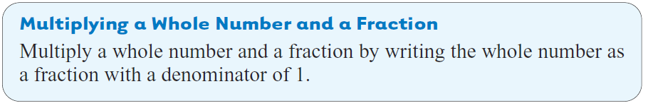

Slide 21
Parallel
Example 4
Multiplying by Whole Numbers
Multiply. Write answers in lowest terms and as whole numbers where possible.
a.
b.
Write 9 as 9/1 and multiply.
3
1
5
2

Slide 22
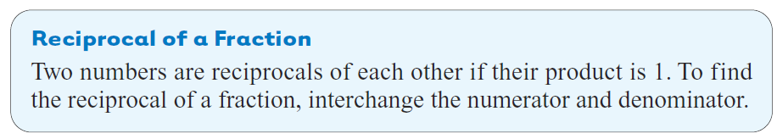
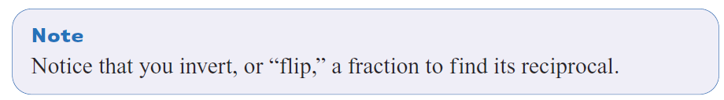
Reciprocal
Slide 2.7- 22

Slide 23
Parallel
Example 1
Finding Reciprocals
Find the reciprocal of each fraction.
a.
b.
c.
d. 2
The reciprocal is
The reciprocal is
The reciprocal is
The reciprocal is

Slide 24
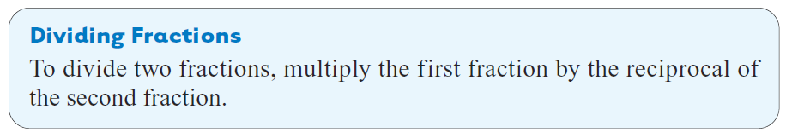
Slide 2.7- 24

Slide 25
Parallel
Example 2
Dividing One Fraction by Another
Divide. Write answers in lowest terms and as mixed numbers where possible.
The reciprocal of
2
Reciprocals
1
Change division to multiplication

Slide 26
Parallel
Example 2
Dividing One Fraction by Another
Divide
1
4

Slide 27
Parallel
Example 3
Dividing with a Whole Number
Divide. Write all answers in lowest terms and as whole or mixed numbers where possible.
a.
Write 9 as 9/1. Use the reciprocal of ¼ which is 4/1.

Slide 28
Parallel
Example 3
Dividing with a Whole Number
Divide. Write all answers in lowest terms and as whole or mixed numbers where possible.
b.
Write 4 as 4/1. The reciprocal of 4/1 is ¼.

Slide 29
(+ and -) Fractions

Slide 30
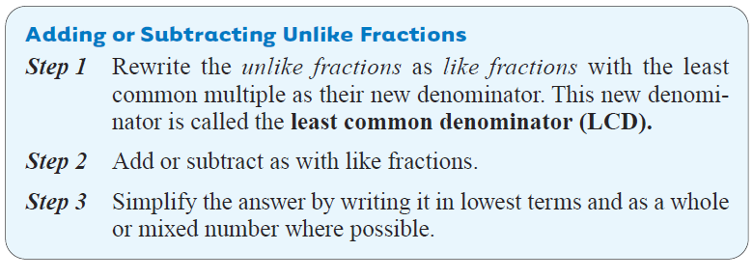
To add unlike fractions, we must first change them to like fractions (fractions with the same denominator.)
Slide 3.3- 30

Slide 31
Parallel
Example 1
Adding Unlike Fractions
Add
The least common multiple of 6 and 12 is 12.
Write the fractions as like fractions with a denominator of 12. This is the least common denominator (LCD).
Step 1
Step 2
Step 3
Step 3 is not needed because the fraction is in lowest terms.

Slide 32
Parallel
Example 2
Adding Fractions
Add the fractions using the three steps. Simplify all answers.
The least common multiple of 4 and 8 is 8.
Rewritten as like fractions
Step 1
Step 2
Step 3
Step 3 is not needed because the fraction is in lowest terms.

Slide 33
Parallel
Example 4
Subtracting Unlike Fractions
Subtract. Simplify all answers.
Rewritten as like fractions
Step 1
Subtract numerators.
Step 2
Step 3
Step 3 is not needed because the fraction is in lowest terms.

Slide 34
Parallel
Example 4
Subtracting Unlike Fractions
Subtract. Simplify all answers.
Rewritten as like fractions
Step 1
Subtract numerators.
Step 2
Step 3

Slide 35

Example
$\frac{7}{4}+\frac{8}{3}$
$\frac{9}{2}−\frac{11}{8}$

Slide 36

Try these:
$\frac{5}{9}+\frac{3}{4}$
$\frac{7}{2}−\frac{8}{3}$
$\frac{4}{5}+\frac{2}{10}$
$\frac{13}{7}−\frac{9}{5}$

Slide 37
Hw Section 1.2 Pg 33
1-5,7-11

